Slide 1


Overview
Engagement Report – 04-September-2026

Slide 2
Engagement Summary
Engagement Overview
Nova Biomedical is a global leader in bioprocessing, clinical diagnostics, and veterinary solutions, driving innovation in patient outcomes
Rapid expansion led to fragmented data across Finance, Sales, Operations, and Supply Chain systems
Heavy reliance on Excel-based reporting and disconnected data sources limited visibility and slowed decision-making
DataPattern engaged to build a centralized, governed analytics platform on Microsoft Fabric (Nova Data Lake)
Transformation Journey
Strategy & Organization (Phase 1 – Completed)
Transformation & Integration (Phase 2 – Active)
Defined and implemented a unified data strategy for Nova Biomedical’s analytics vision on Microsoft Fabric (Nova Data Lake).
Migrated legacy systems (AI & Nova) to a centralized platform
Integrated initial source systems: SAP, BW, SQL Server, JDrive, SharePoint
Migrated legacy reports to the data lake
Established foundational KPI models and dashboards (Sales, Marketing, Operations)
Integrated multiple source systems: Epicor, NetSuite, Salesforce, SAP
Built unified data platform with consistent business logic and definitions
Delivered consolidated outputs:
  Booking – Unified booking model across Legacy AI & Nova (Live)
  Shipments – Centralized shipment & logistics tracking (In Progress)
  Sustainability – Scope 1 & 2 emissions reporting (In Progress)
Advancing real-time reporting (DirectQuery) and KPI standardization

Slide 3
Key Projects and What We Delivered
Strategy & Organization
Phase 1
Transformation & Integration - Phase 2
Apr 2026 – Enhancements (R2)
Booking and shipment dashboards
Profitability (standard cost)
Customer segmentation implementation
Sustainability – Reports development
Focus: Reporting and analysis
Built booking data model (Epicor + NetSuite)
Set up Medallion architecture
Migrated reports to data lake
Created dashboards (Sales, Marketing, Operations)
Developed unified models (Salesforce + Epicor) and KPI reports
Delivered Daily Flash (assembly, manufacturing, master)
Completed platform migration (NOVA → unified workspace)
Outcome:
Data and reporting foundation in place, but definitions and booking logic not fully aligned
Dec 2025 – Establishment
Ingest data from BW, SAP, SQL Server, JDrive, SharePoint
Focus: Data integration
Feb 2026 – Harmonization
Rebuild FP&A models (Databricks)
Create semantic layer
Validation and sign-off
Focus: Single data model
Jan 2026 – Alignment
Product, region, territory, and transaction standardization
Focus: Common definitions across systems
Mar 2026 – Enhancements (R1)
Booking process updates
New data go-live
Historical data extraction
Customer segmentation definition
Sustainability – Design & Development
Focus: Transition to new system
May 2026 – Enhancements (R3)
• Booking & Shipment Process updates
• One Nova Pending Shipment- Design
• Analyzer Installed Base report
• Creating Pivotal Semantic Model
• Sustainability – Reporting development
• Australia State government – Reporting Focus: Reporting and analysis

Slide 4
Key Projects and What We Delivered
Transformation & Integration - Phase 2
June 2026 – Enhancements (R4)
• Booking & Shipment Support
• One Nova Pending Shipment- Delivered
• Creating Pivotal Semantic Model Delivered
• Sustainability – Delivered
Focus: Reporting and analysis
July 2026 – Enhancements (R5)
Ecc Migration
One Nova Profitability
Historical contracts
One Nova openshipments
Sales Quota Dashboard
Focus: Reporting and analysis

Slide 5
Team Structure & Escalation Model
Team Structure
Escalation Model
Routed through the client and project
leadership teams for review and action
Nova Biomedical - Team
Technical Team
Delivery Manager
Program
Manager
Head of Data and AI
Jay Jantz
DP - Management Team
DP - Technical Team
Program Manager
Jennifer Easwaramurthi
Data Engineers
Thenmozhi
Subbarayudu
Devasenathipathy
Abirami
Delivery Manager
Dhamodaran Rameshbabu

Slide 6
Monitoring & Governance Capabilities
1. Pipeline Monitoring (Daily Operations)
2. Automated Event-Based Monitoring (Activator Framework)
Dedicated monitoring ownership assigned for all critical data pipelines
Continuous daily monitoring of pipeline executions across environments
Monitoring includes:
Pipeline execution status (Success / Failure)
Data refresh completion and timeliness
Identification of:
  Failed runs
  Delayed executions
  Partial data loads
Operational Activities:
Daily validation of critical datasets before reporting usage
Immediate triaging and assignment of issues
Coordination with development team for quick fixes
👉 Outcome:
Ensures high data availability, reliability, and quick turnaround for issue resolution, minimizing impact on business reporting
Implemented event-driven monitoring using Activator framework
Configured rules to continuously monitor pipeline behavior
Automated Detection Covers:
Pipeline failures
Data delays or missing loads
Execution anomalies and unexpected patterns
Trigger-Based Actions:
Automatic alerts based on predefined conditions
Notification for:
  Failed jobs
  SLA breaches
Enables proactive intervention before business impact
Advanced Capability:
Transition from manual checks → intelligent event-driven monitoring
Supports near real-time observability of pipelines
👉 Outcome:
Enables proactive, real-time issue detection and faster response, reducing dependency on manual monitoring and improving operational efficiency

Slide 7
Engagement Model - How We Operate
Work Intake Process
Delivery Tracking & Execution
Issue Tracking & Resolution
All incoming requests are first documented in OneNote with:
  Business requirement
  Context and expected outcome
Requests are then logged into a Delivery Tracker (detailed task sheet):
  Task ID, Owner, Priority, Timeline, Effort
Tasks are prioritized (High / Medium / Low) and assigned accordingly
All tasks are tracked in a Central Delivery Tracker sheet
Each task includes:
  Owner & support team
  Start & due dates
  Effort estimation
  Status (Completed / In Progress / Not Started / On Hold)
  Dependencies & comments
Dedicated Issue Tracker maintained for all blockers
Each issue captures:
  Description of problem
  Priority & deadline
  Assigned owner
  Execution type (e.g., Dataflow issue)
  Root cause & resolution steps

Slide 8
AI Nova Biomedical Knowledge Agent
Implemented an AI-driven knowledge agent that transforms project documentation and issue history into a searchable system to accelerate onboarding, streamline delivery, and ensure seamless knowledge transition
Benefits
Created a dedicated ChatGPT workspace for the project
Configured it to:
  Use project documentation as knowledge source
  Support query-based access
Supports seamless transition → Knowledge is retained and accessible, reducing dependency on individuals
Accelerates onboarding → New members can quickly understand systems without repeated KT
Query-Based Knowledge Access
How it Helps
Enables scalable operations → Team can grow without losing context or slowing down delivery
Used as a central knowledge access layer for the project
Provides instant access to:
  Data Flow Diagram
  Process Flow Diagram
  Mapping Design sheet
  Issue history and resolutions
Enables query-based interaction with project knowledge
Enabled team to:
  Ask questions on:
    Data flows
    Transformations
  Get instant contextual answers
    Issue fixes
Improves delivery efficiency → Faster issue resolution using past solutions and documented knowledge
Ensures consistency in execution → Standardized understanding of data and processes across the team

Slide 9
Weekly Status Report – Nova Biomedical
Management Report : | Week of August 31– September 04, 2026
Highlights & Accomplishments
Completed Tasks Task No – 109: Implemented and validated the relationship/key fix, confirmed the Build Priorities report is working as expected Task No-82 :Implemented changes to display only available reps in the lookup and added pacing for each rep. Task No-112 : Provided the required access to the requested users and asked Joe to validate the report access from his end.
Milestone & Supporting Activities
Milestone Area | Task | Status | Remarks
ECC Migration | Ecc support | 🟡In Progress | Continuing to provide support for the migration
Enable service accounts | Service account | 🟡In Progress | Reviewing the service-account limitation and working toward a solution that avoids dependency on individual employee credentials, eliminating a single point of failure for critical reporting and automation.
CRM (OpFocus) | opFocus | 🟡In Progress | Ingested the required Pivotal tables into Bronze. Providing Bronze access to the OpFocus team is currently in progress.
Upcoming Activities ( Next Week Plan)
One Nova Booking & Shipment , One Nova Pivotal & One Nova open shipments, One Nova Profitability. - Continue to Support. ECC Migration – Continue to Support.
Risk & Issues
None

Slide 10




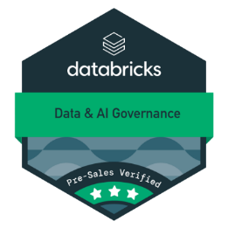

Professional Accomplishment
Certification
Badges
Subbarayuddu
Data Engineer
Thenmozhi
Data Engineer
Abirami
Data Engineer
Devasenathipathy
Data Engineer
4
Certifications
3
Certifications
3
Certifications
4
Certifications
Databricks Certification
Databricks Certification
Databricks Certification
Databricks Certification
● Data Engineer Associate
● Data Engineer Associate
● Data Engineer Associate
● Data Engineer Associate
● Data Engineer Professional
● Data Engineer Professional
● Data Engineer Professional
● Data Engineer Professional
● Data Analyst Associate
● Data Analyst Associate
● Data Analyst Associate
● Machine Learning Associate

Slide 11
Client Testimonial
Project : Sustainability
Developer: Tenny &Abi
Kyle White (Sustainability Engineer – Operations) and Gopi Palamadai (Data Architect – IT) appreciated the strong progress and high quality of delivery, highlighting that the solution is well aligned with the agreed requirements and progressing smoothly.
The team demonstrated strong ownership, consistent effort, and a clear understanding of requirements, with their performance standing out strongly despite operating in an offshore model.
Recognition was given to effectively handling complex components such as company car logic and detailed reconciliation. Proactive communication, initiative, and seamless execution across dataflows, pipelines, calculations, and reporting were also noted. Overall, the solution is nearing completion with a high level of maturity and readiness.
Project: DataLake Reporting & Analytics
Developer: Sridhar & Tenny
John Giebel Hausen (Sr. Director, North American Field Support) appreciated the team’s efforts, stating, “Fantastic work!”
He highlighted that the updated version, aligned with the calendar year, effectively meets business needs and provides a highly impactful reporting experience through clear visual and numerical summaries.

Slide 12


ssmoses@datapattern.ai
+1 508 654 3779
Time To Transform
Is …
…
NOW

Slide 13
Nova Biomedical – Business Process
Business Foundation
What Nova Does
Nova Biomedical operates in the global diagnostics and life sciences market
Supplies:
Diagnostic instruments (analyzers)
Consumables (reagents, test kits)
Service & maintenance contracts
Commercial Engine
(Sales Orders)
Secure customer bookings (orders)
Represent future market demand
“Committed revenue” at this stage
Orders → Future revenue pipeline
Operational Engine
(Shipments)
Supply chain fulfills and ships orders
Timing and backlog impact customer satisfaction
Converts bookings into actual deliveries
Bookings → Shipments
Financial Engine
(Revenue)
Revenue recognized after delivery
FP&A tracks actual revenue vs forecasts
Monitors margin, costs, and profitability
Shipments → Recognized Revenue &Profit
Financial → Revenue & Margin
Nova Biomedical operates across interconnected Sales , Operations and Finance Layers
The Business Challenge
Struggle to connect bookings, shipments, and revenue seamlessly
Data inconsistencies, limited visibility, and fragmentation
Leadership cannot effectively track end-to-end performance
Sales (Booking)
Operations
(Shipments)
Finance
(Revenue & Margin)
Financial Engine
Sales (Bookings)
Operations (Shipments)
Nova Operates across Interconnected Sales , Operations and Finance Layers

Slide 14
Project Coverage
  Unified view of all booking data across Legacy AI & Legacy Nova — single model for revenue reporting and analysis.
    Dec 2025: Data integration (SAP, BW, Pivotal, JDrive)
    Jan 2026: Business alignment (profit centres, forex, territories)
    Feb 2026: Harmonization of AI & Nova logic
    Mar 2026: Contract booking redesign & historical migration
    Apr 2026: Booking dashboards & profitability reporting ← Live
  Centralized shipment and delivery tracking across Legacy AI & Legacy Nova — improves supply chain visibility and logistics performance.
    Design: Completed
    Development: In Progress
    Next: FP&A Semantic Model integration
  Consolidates global utility consumption data; automates Scope 1 & Scope 2 emissions calculations with real-time reporting.
    Requirements & Data Collection: Completed
    Design: Completed
    Ingestion: In Progress
    Next: Semantic Model Development
Consolidated Booking
Consolidated Shipments
Sustainability

Slide 15
Engagement Overview + Journey
Transformation Journey
Engagement Overview
Current Focus
Phase 2 – Standardization & Data Harmonization (Jan – Feb)
Implemented medallion architecture (Bronze, Silver, Gold)
Standardized financial and operational dimensions across systems
Established scalable semantic models for reporting consistency
Phase 3 – Business Use Case Enablement (Mar – Apr)
Developed Consolidated Booking Report for unified revenue visibility
Built Shipment & Analyzer Base reports for operational and asset insights
Enabled Sustainability reporting framework (ESG metrics)
Migrating legacy Power BI reports to real-time Fabric-based reporting
Phase 1 – Foundation Setup (Dec – Jan)
Built centralized Fabric-based Lakehouse (One Lake)
Integrated enterprise data from Epicor, Salesforce, NetSuite, SAP, and other systems
Phase 0 – Initial Phase (May – Dec)
Support Activities to build AI Data Lake
Tenant to Tenant Migration from AI to Nova data Lake
Eliminated direct source reporting dependencies
Eliminated direct source reporting dependencies
Nova Biomedical is a global leader in bioprocessing, clinical diagnostics, and veterinary solutions, driving innovation in patient outcomes
Rapid expansion led to fragmented data across Finance, Sales, Operations, and Supply Chain systems
Heavy reliance on Excel-based reporting and disconnected data sources limited visibility and slowed decision-making
DataPattern engaged to build a centralized, governed analytics platform on Microsoft Fabric (Nova Data Lake)
Advancing real-time reporting (DirectQuery) and KPI standardization
Expanding cross-functional analytics (Finance, Supply Chain, Customer Ops)
Scaling data pipelines and enterprise integrations
Driving adoption of unified, business-ready dashboards

Slide 16
Project Overview - Nova Biomedical Technical Challenges & Solution
Technical Challenges
Solution
1. Fragmented & Disconnected Process
Data spread across multiple systems and reports
No unified view of:
Bookings
Shipments
Financial performance
👉 Impact: Inconsistent reporting and lack of a single source of truth
2. Misalignment Between Business Activity & Financial Reporting
Booking recognition tied to billing instead of actual execution (shipment/orders)
Delay in reflecting true business performance
👉 Impact: Leadership lacks timely visibility into bookings
Current Engagement with DataPattern
Nova Biomedical operates across multiple business functions (Finance, Sales, Operations, Supply Chain) with data flowing through:
Source Systems: ERP, CRM, Financial & Operational platforms (SAP, NetSuite, Salesforce, Epicor – SQL server etc.)
Business Flow:
  Contracts → Orders → Shipments → Billing → Revenue
  Centralized Data Lake :
    Source Data Integration & Business Logic Transformations
    Medallion Architecture in Fabric
    Semantic Model Implementation
Reporting Layer:
  Manual Report Process to Consolidated
  Separate reports for bookings, shipments, financials ,Sustainability
  Limited integration across systems and functions
Business relies on this flow to track:
  Booking performance
  Contract fulfillment
  Financial outcomes
3. No End-to-End Visibility of Contract Performance
Contracts not directly linked to:
Actual bookings
Shipment execution
No structured tracking (monthly / quarterly / yearly)
👉 Impact: Inability to measure performance against commitments
4. Inconsistent Business Logic Across Systems
Differences in:
Booking definitions
Financial dimensions (profit centers, territories, forex)
Legacy systems (AI & Nova) not aligned
👉 Impact: Conflicting metrics and reduced trust in data
5. Heavy Manual Effort & Reporting Delays
Manual consolidation and reconciliation across systems
👉 Impact: Slow decision-making and increased operational risk

Slide 17
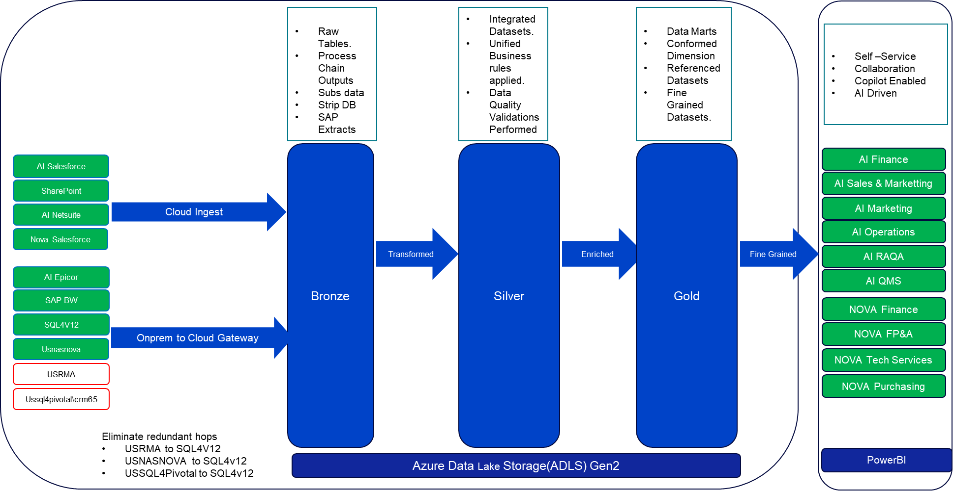
NOVA Dataplatform- Data Democritization - Medallion Architecture(2026)
Completed
Pending

Slide 18
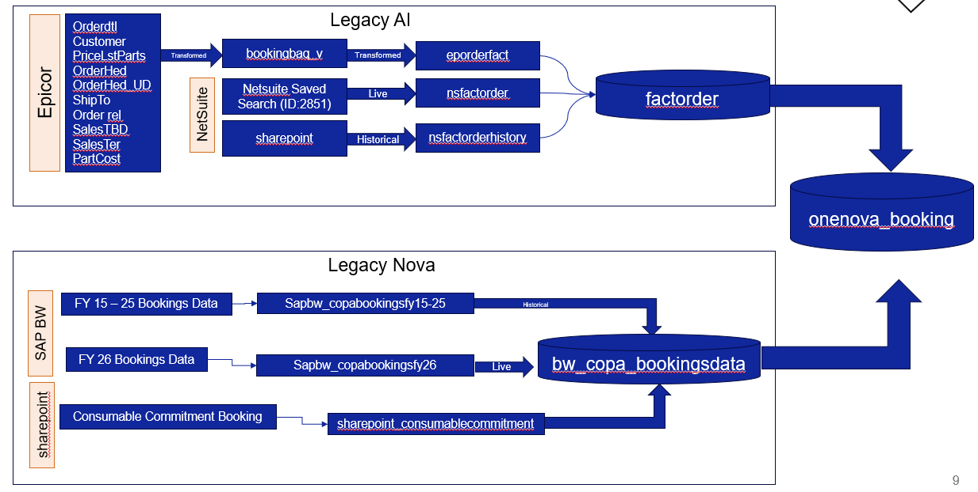
Consolidated Booking Project Status , Milestone & Updates
The Consolidated Booking Report is a unified view of all booking (revenue/order) data across Legacy AI and Legacy Nova into a single, consistent data model for reporting and analysis.
Our Journey (Transformation Timeline)
December – Foundation Setup
Ingested data from BW, SAP, Pivotal, Adaptive, JDrive
Established base data pipelines and storage
January – Business Alignment
Defined:
  Profit centers
  Territory mappings
  Forex logic
  Transaction classifications
February – Harmonization Phase
Unified logic across:
  Legacy AI workflows
  Legacy NOVA workflows
  Eliminated inconsistencies
March – Business Process Transformation
  Contract booking redesign
  Historical data migration planning
April – Go-live (Target)
  Booking dashboards
  Profitability reporting
Client : Xavier Boutin , Yanting Zeng & Bower, Ryan
Development by : Sridhar
Project Owned by :Gopi Palamadai
Project Status - Live
Project Kick off : 01/12/2026
Project Completion Status - 100 %

Slide 19
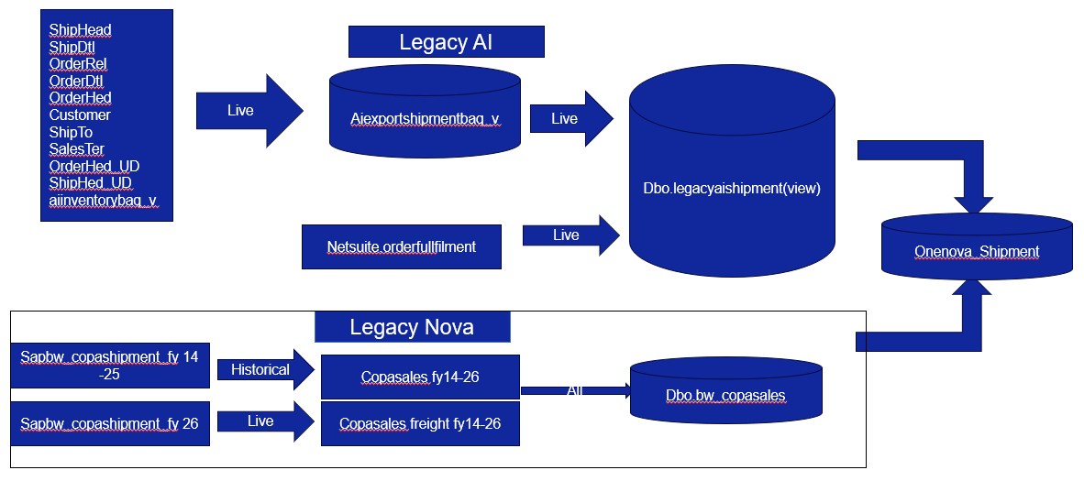
Consolidated Shipping Project Status , Milestone & Updates
A centralized view of shipment and delivery data that tracks logistics performance, identifies delays, and improves supply chain visibility and efficiency across Legacy AI & Legacy Nova
Client : Xavier Boutin , Yanting Zeng &
Bower, Ryan
Project Owned by : Gopi Palamadai
Project Kick off Date: 03/03/2026
Development by : Sridhar
Project Status : Development
Project Completion Status : 60%
Design - Completed
Development – In Progress
Next stages : -
Project Deadline : 03/27/2026

Slide 20
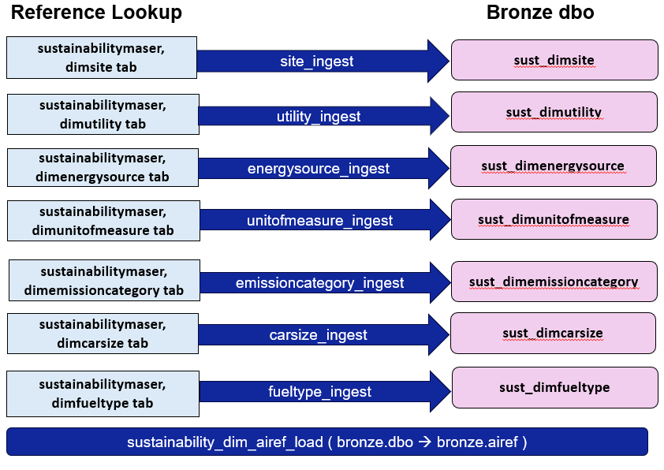
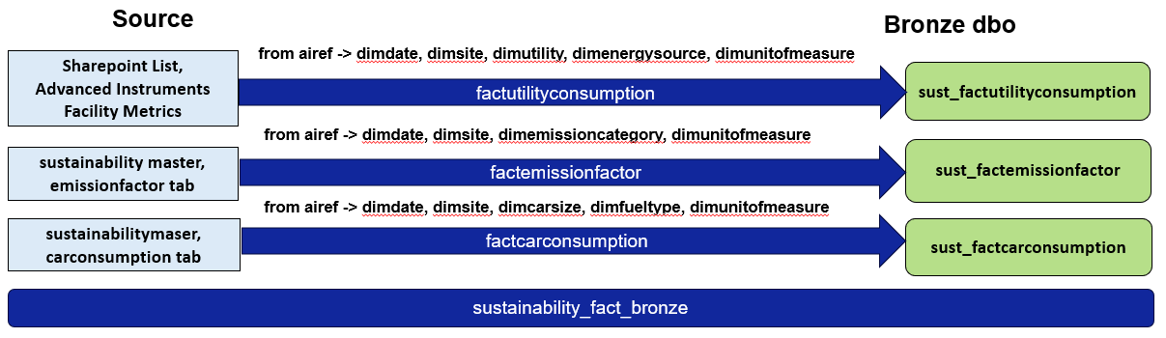
Sustainability Project Status , Milestone & Updates
Sustainability report consolidates all global Nova and AI utility consumption data, automates Scope 1 and Scope 2 emissions calculations, and enables real-time reporting throughout the year.
Client : Kyle White & Bjoern Carle
Project Owned by – Jay Jantz
Project Kick off – 02/20/2026
Development by : Thenmozhi
Project Status - Development
Project Completion Status - 50%
Requirement Gathering – Completed
Data Collection - Completed
Design - Completed
Ingestion - In Progress
Next stages : Semantic Model Development
Project Deadline : 04/03/2026

